Slide 1

Customer Shopping Behavior Analysis
This project analyzes customer shopping behavior using transactional data from 3,900 purchases across various product categories. Our goal is to uncover insights into spending patterns, customer segments, product preferences, and subscription behavior to guide strategic business decisions.

Slide 2

Dataset Overview
Dataset Scope
Data Quality
Our analysis covers 3,900 customer transactions with 18 key features spanning demographics, purchase details, and shopping behavior patterns.
The dataset is highly complete with minimal missing data:
Only 37 missing values in Review Rating column
Missing ratings imputed using median rating by product category
Customer demographics (Age, Gender, Location, Subscription Status)
All columns standardized to snake case for consistency
Purchase details (Item, Category, Amount, Season, Size, Color)
Shopping behavior (Discounts, Promo Codes, Previous Purchases, Review Ratings)

Slide 3
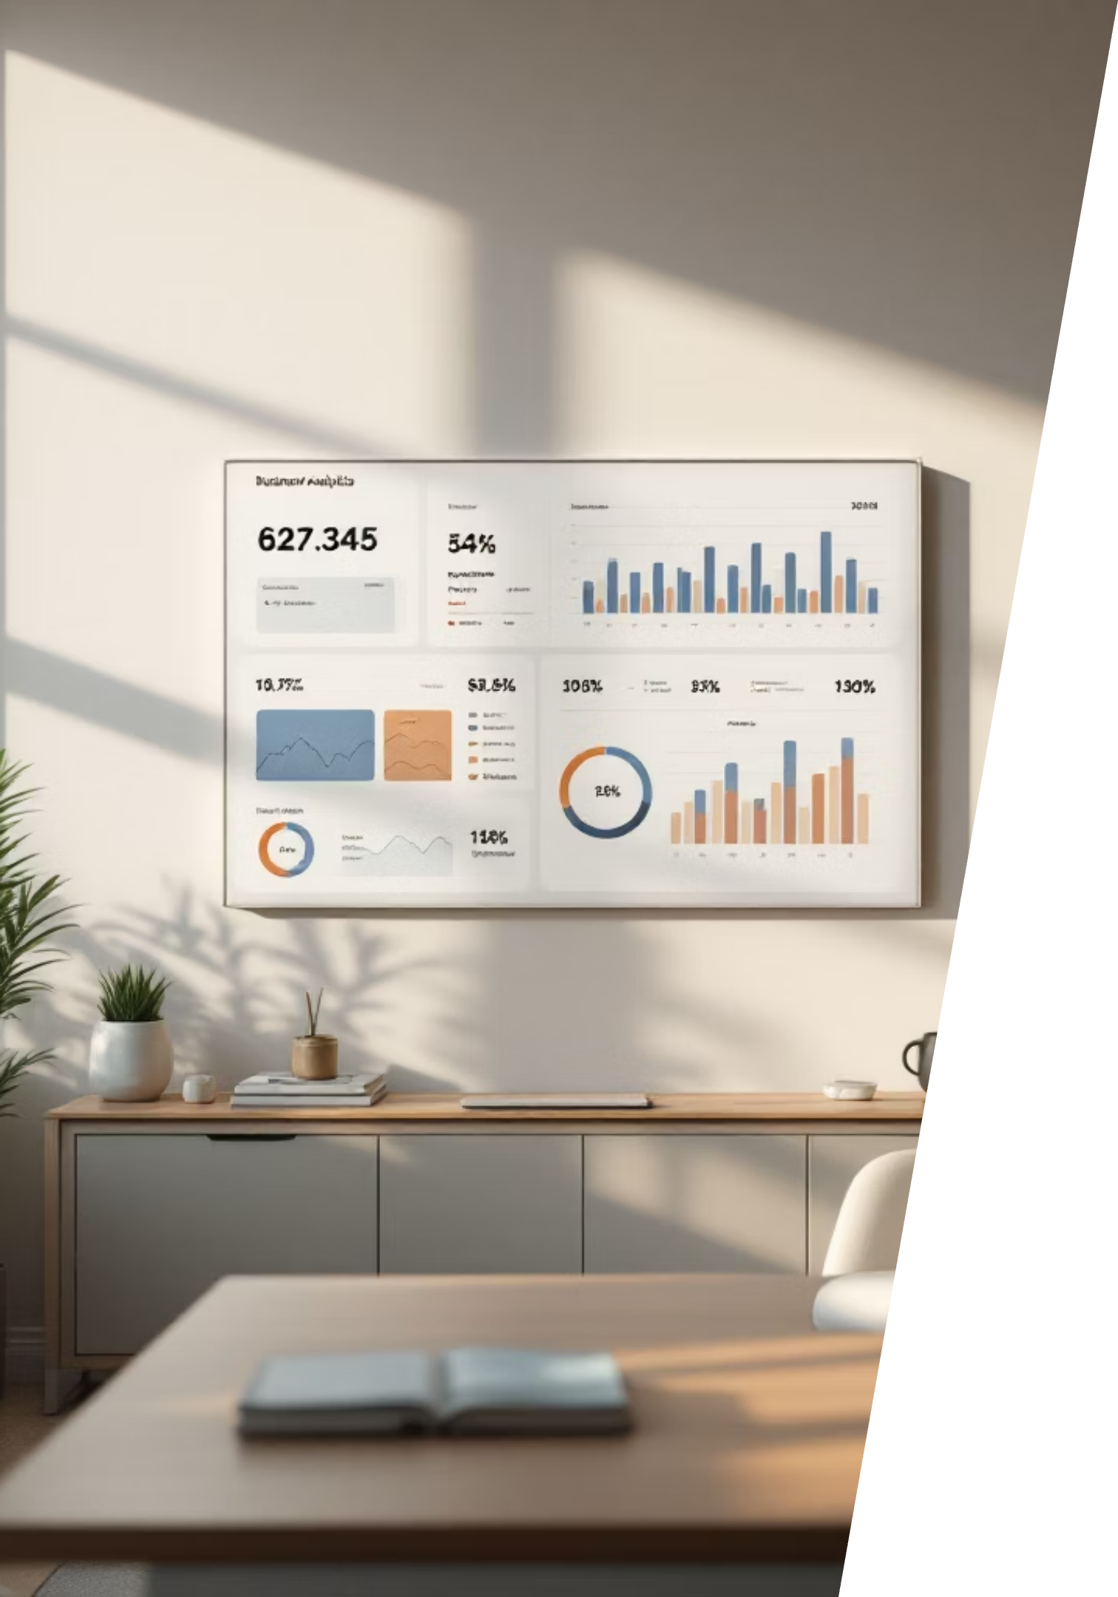
Key Customer Insights
3.9K
$59.76
3.75
Total Customers
Average Purchase
Average Rating
Analyzed across all product categories
Consistent spending across segments
Strong customer satisfaction overall
27%
Subscription Rate
Significant growth opportunity
Gender Distribution
Age Group Performance
Male customers generated $157,890 in revenue compared to $75,191 from female customers, representing a 2:1 revenue ratio.
Young Adults lead with $62,143 in total revenue, followed closely by Middle-aged customers at $59,197.
Shipping Preferences
Express shipping users spend slightly more ($60.48) than Standard shipping customers ($58.46).

Slide 4
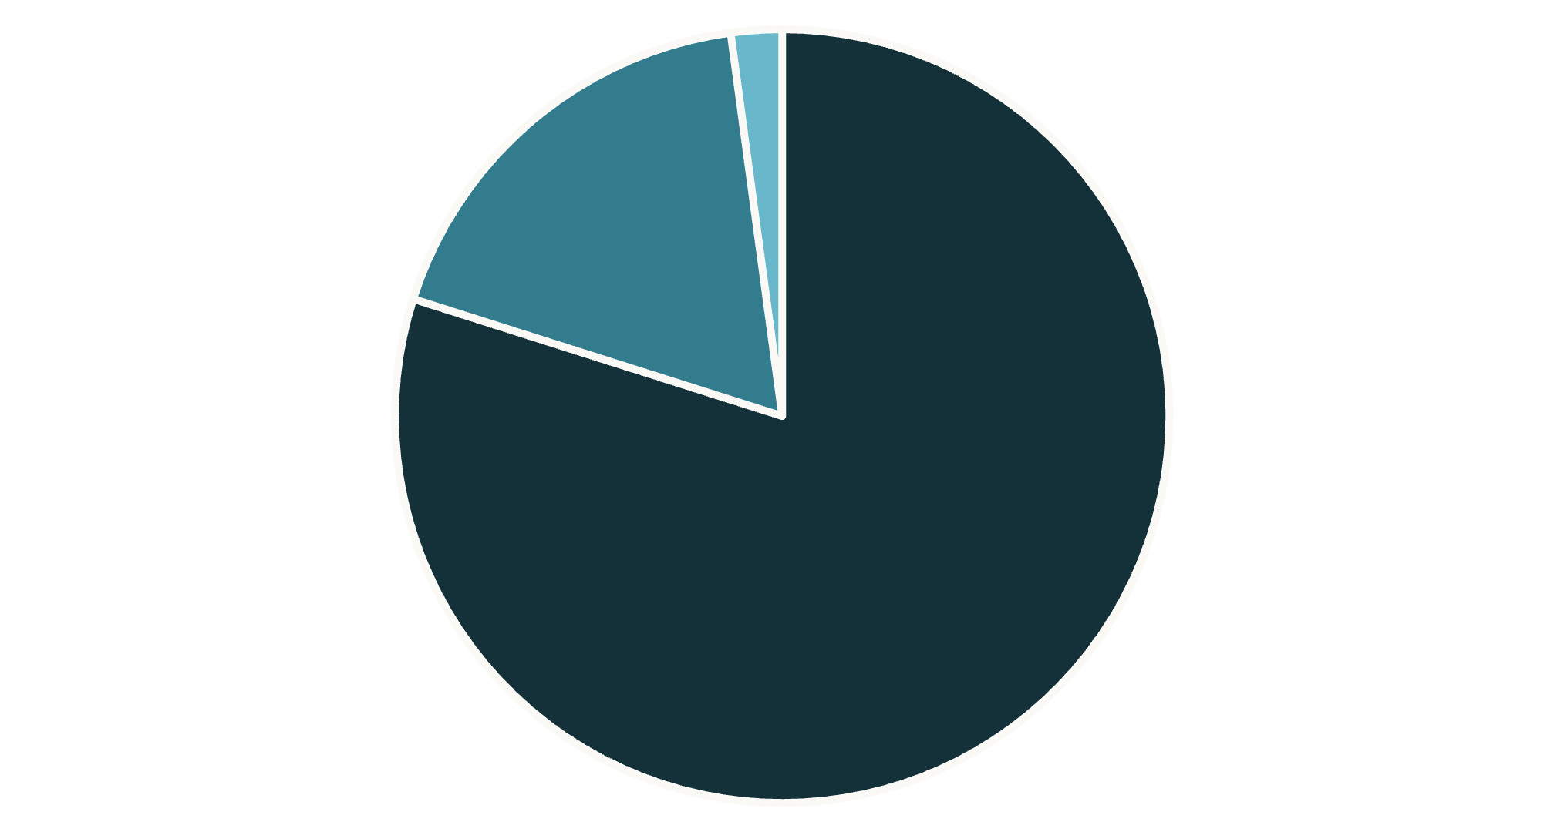

Customer Segmentation Analysis
Segment Breakdown
Our customer base is dominated by Loyal customers (80%), representing a strong foundation for sustained revenue.
Key Finding: Among repeat buyers with more than 5 purchases, 958 are subscribers while 2,518 are not—a significant opportunity for subscription conversion.
Loyal
Returning
New
1
2
3
Loyal Customers
Returning Customers
New Customers
3,116 customers with consistent purchase history driving the majority of revenue
701 customers showing repeat behavior—prime targets for loyalty programs
83 first-time buyers requiring engagement strategies to drive retention

Slide 5




Strategic Recommendations
Boost Subscription Adoption
With only 27% of customers subscribed, promote exclusive benefits and rewards to convert the 2,518 repeat buyers who aren't yet subscribers. Subscribers show similar spending patterns but offer predictable revenue.
Implement Customer Loyalty Programs
Reward repeat buyers to accelerate their journey into the Loyal segment. Focus on the 701 Returning customers with targeted incentives and personalized experiences.
Optimize Discount Strategy
839 customers used discounts while spending above average. Review discount policies to balance sales growth with margin protection—some products show 50% discount rates.
Targeted Marketing Campaigns
Focus efforts on Young Adults (highest revenue at $62,143) and express-shipping users (higher average spend). Highlight top-rated products like Gloves (3.86 rating) and Sandals (3.84 rating) in campaigns.

